Slide 1
RNA-Seq Definition & Technologies
Porto, 16th & 17th March 2023

Slide 2

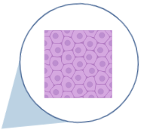


Notes:
Sequencing RNA reveals molecular processes a cell type/tissue
Identifies functional elements of genome
Enables understanding of development, disease, etc.

Slide 3
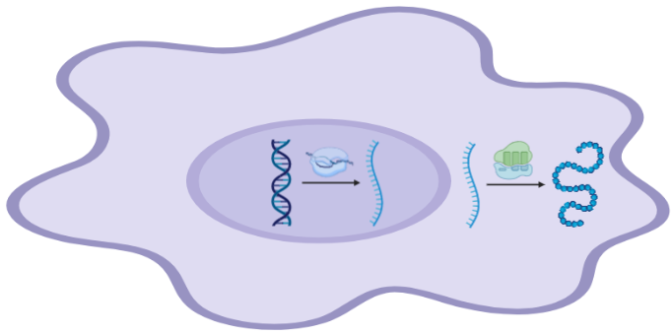
Reveals molecular processes of a cell/tissue
Identifies functional elements of a genome
Enables understanding of development, disease etc.
Transcription
Translation
Amino acid -> Protein
DNA
RNA
Notes:
Sequencing RNA reveals molecular processes a cell type/tissue
Identifies functional elements of genome
Enables understanding of development, disease, etc.

Slide 4
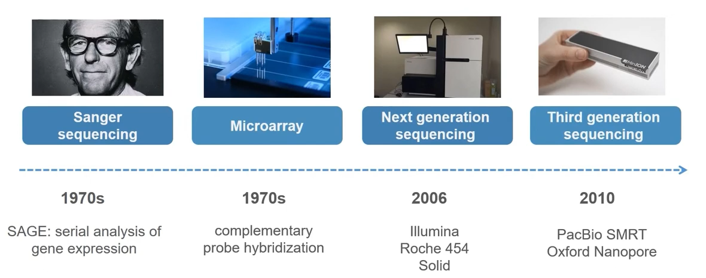
Transcription Analysis Methods

Slide 5
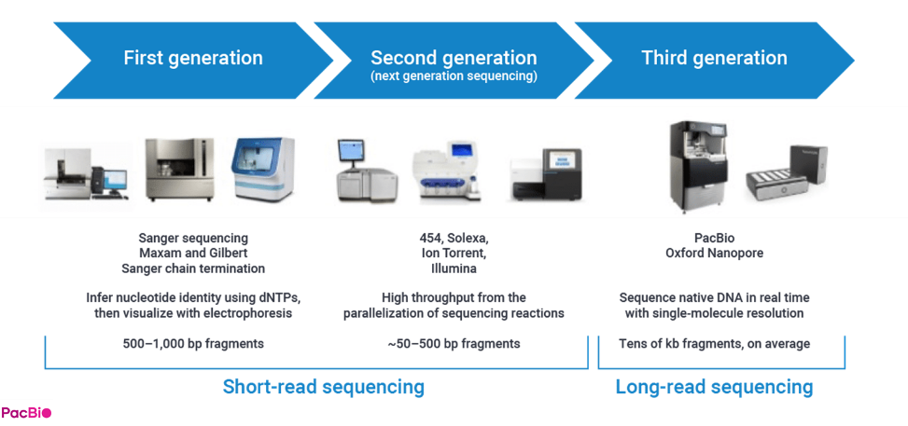
Current capabilities

Slide 6
What have we used RNA-Seq for?
Describing evolutionary adaptation
Cross-species comparisons
Identifying genetic basis for disease resistance

Slide 7
What have we used RNA-Seq for?
Describing evolutionary adaptation
Cross-species comparisons
Identifying genetic basis for disease resistance

Slide 8
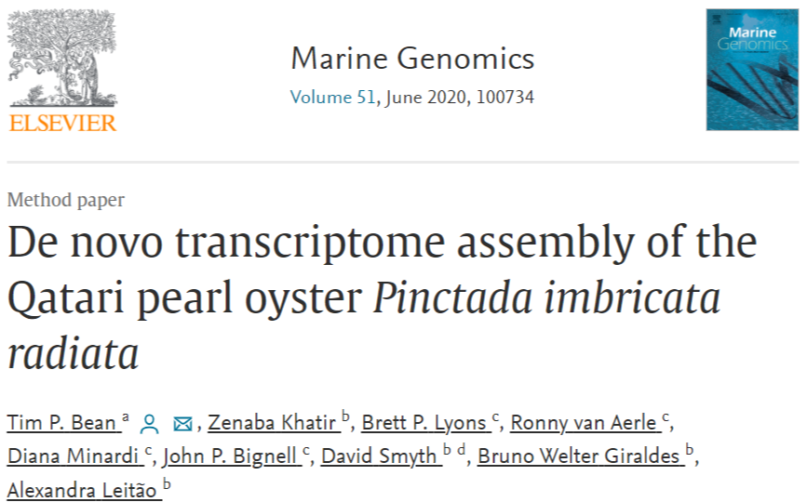
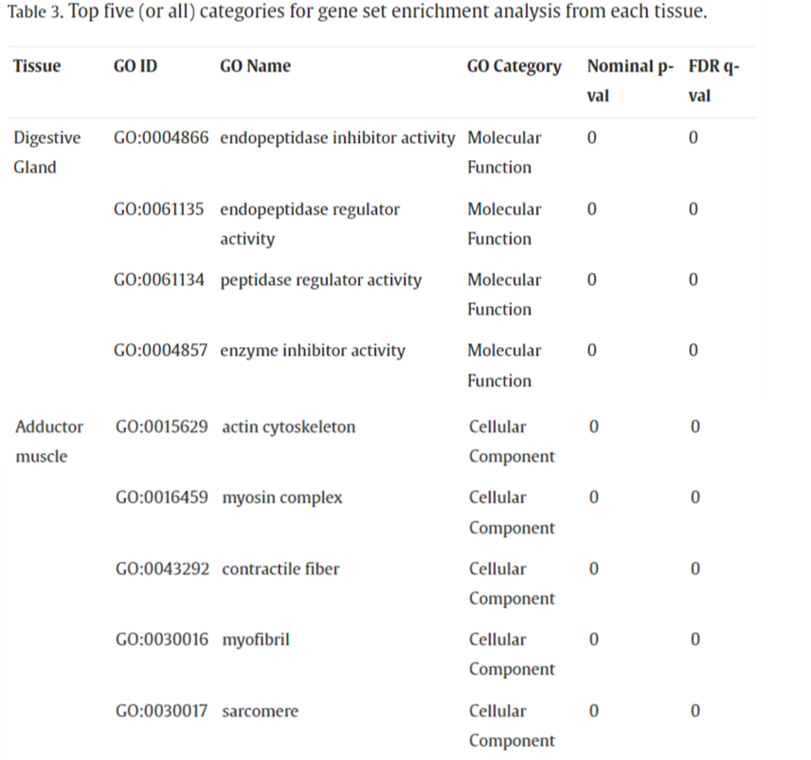
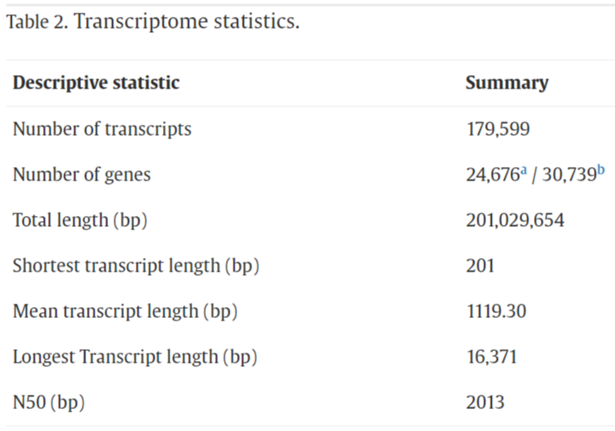
Close evolutionary distance to Pinctada imbricata fucata
Highlights differences in immune genes and distinctive transposon families, suggesting recent adaptive divergence.

Slide 9
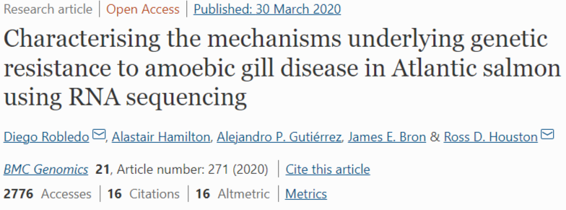
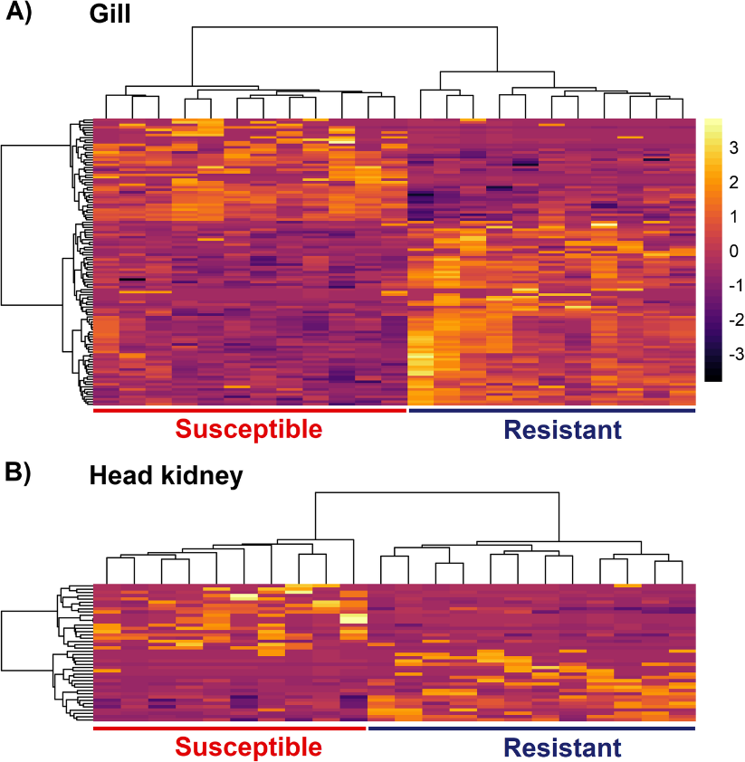
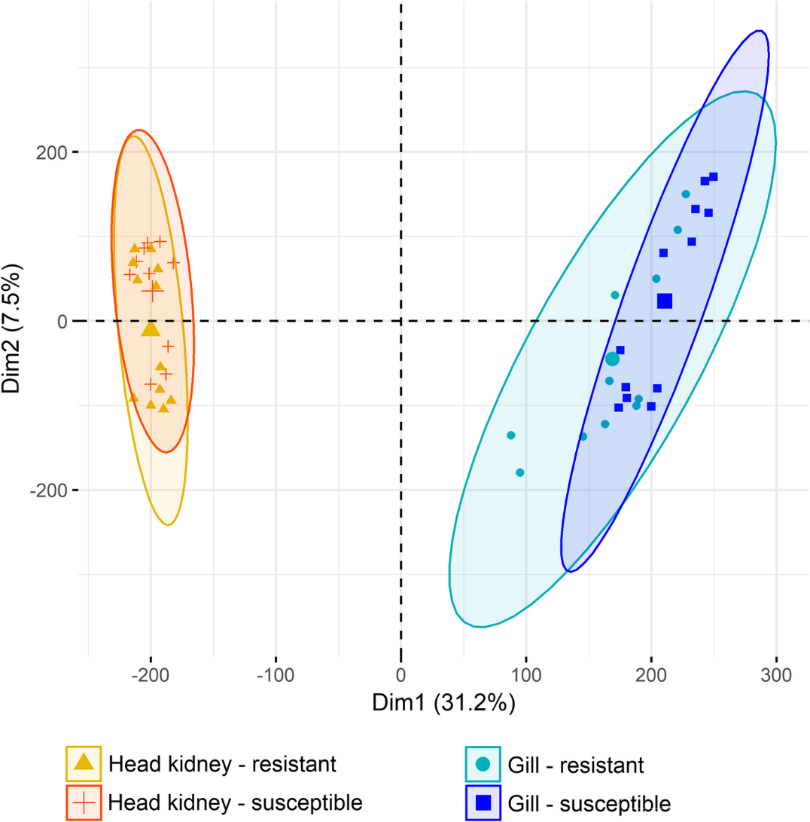
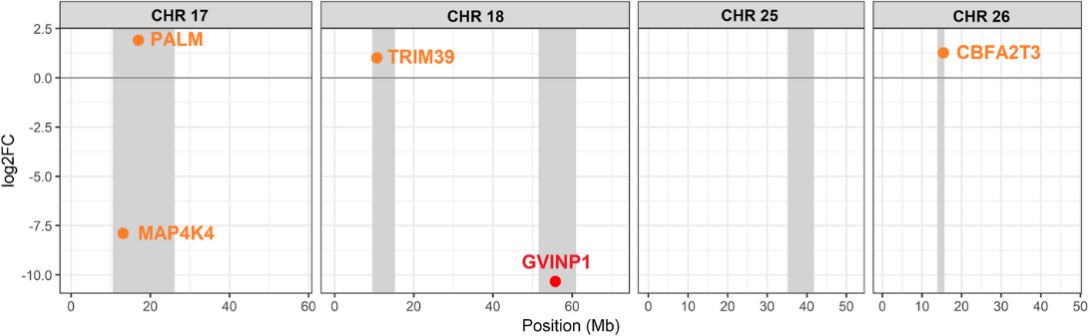
Potential candidate genes of interest

Slide 10
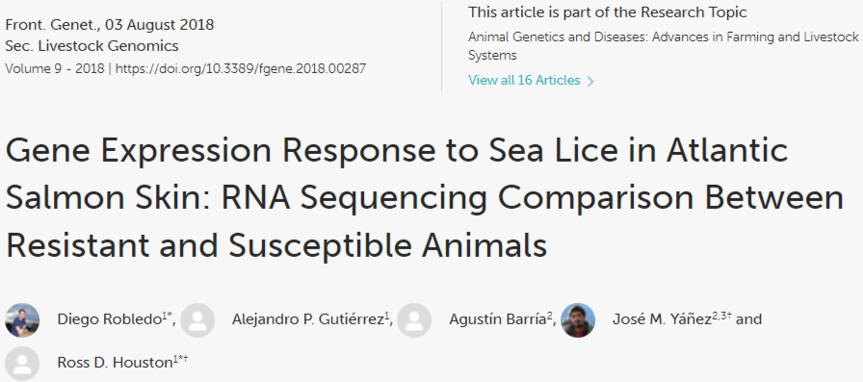
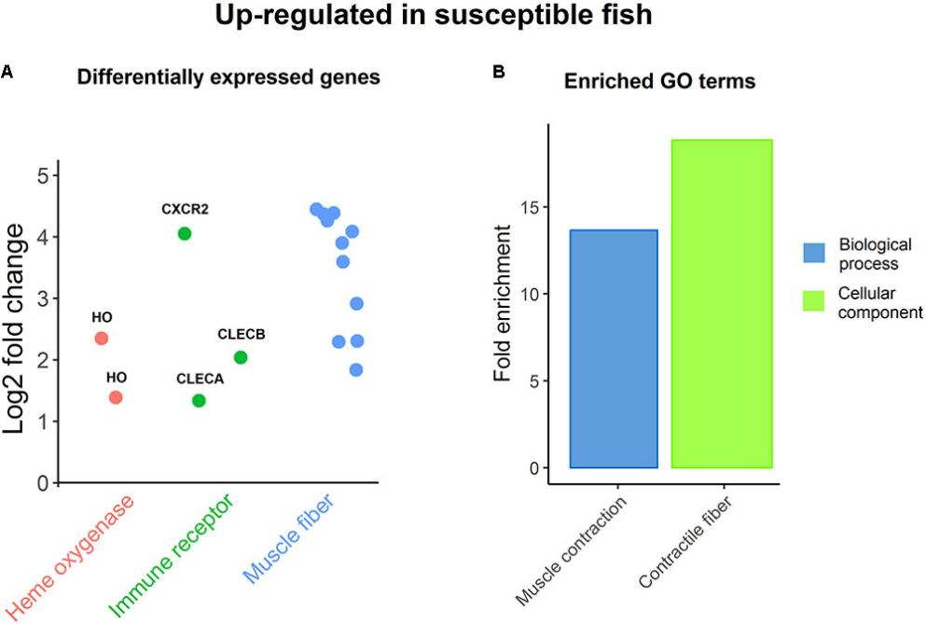
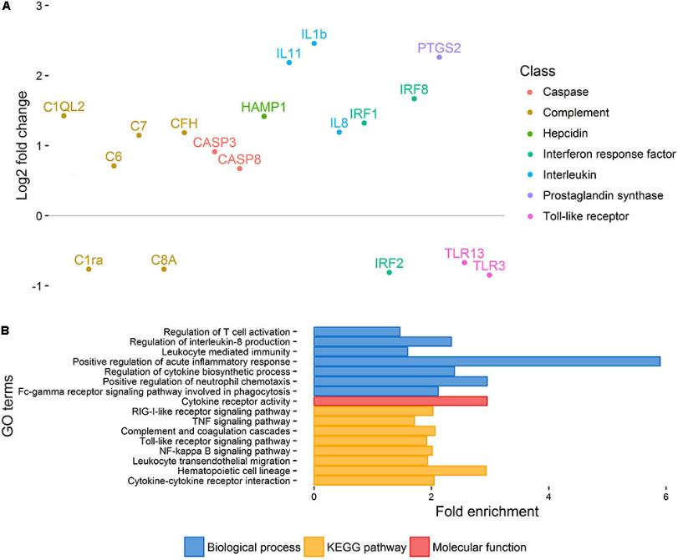
Differences in immune response and pattern recognition genes, also myogenic and iron availability factors.

Slide 11
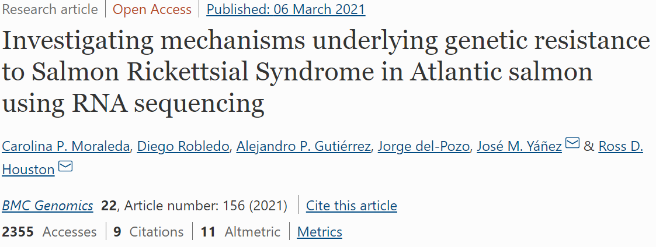
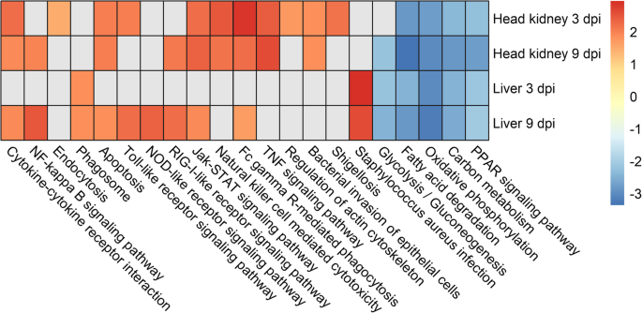
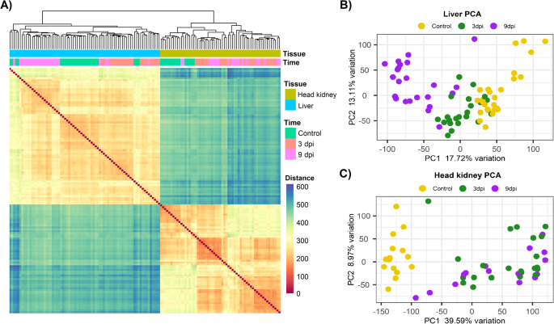
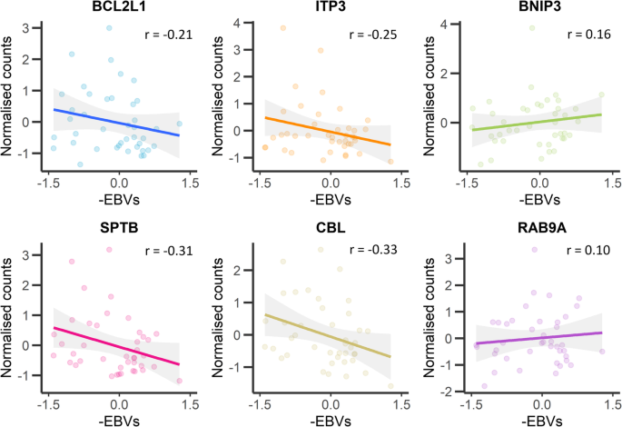
Several networks correlated with SRS resistance EBVs : Apoptosis, cytoskeletal organisation, and the inflammasome.

Slide 12
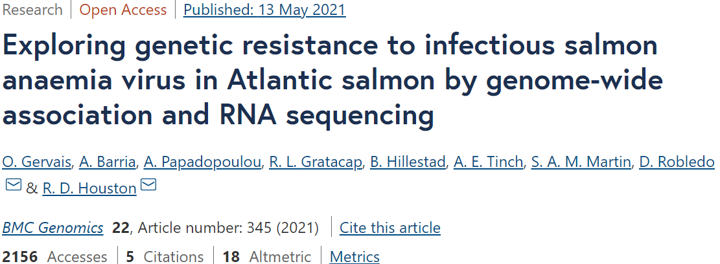
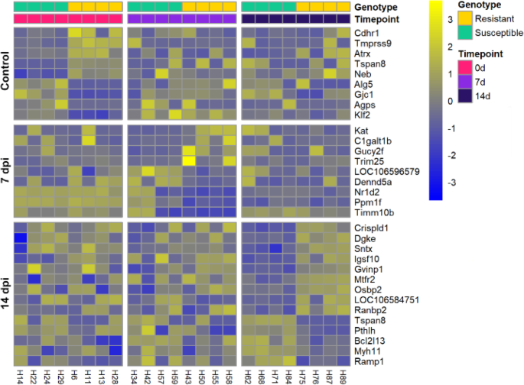
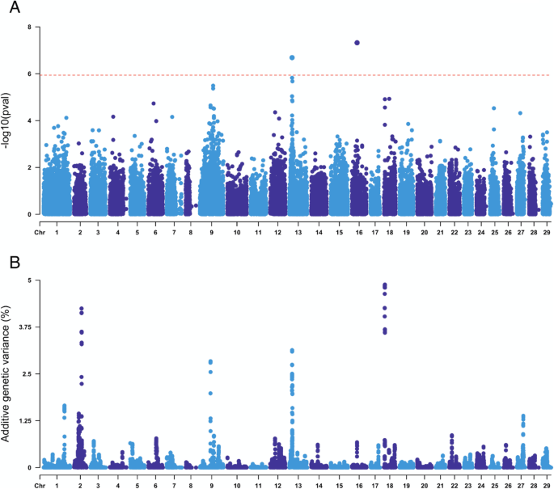
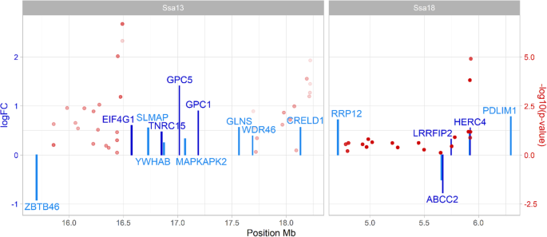
GWAS vs RNA-Seq hits
Significance of IFN response elements highlighted for resistance

